Slide 1
Getting Started with Swagger Tools
COURSE OVERVIEW

Slide 2
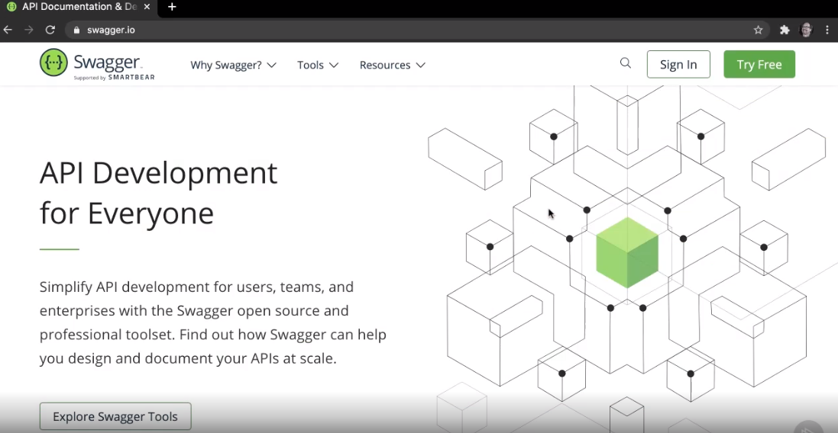

Slide 4
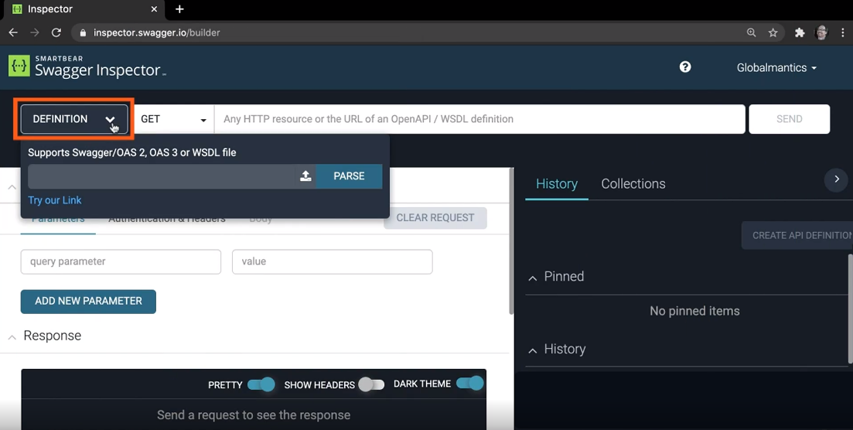

Slide 5
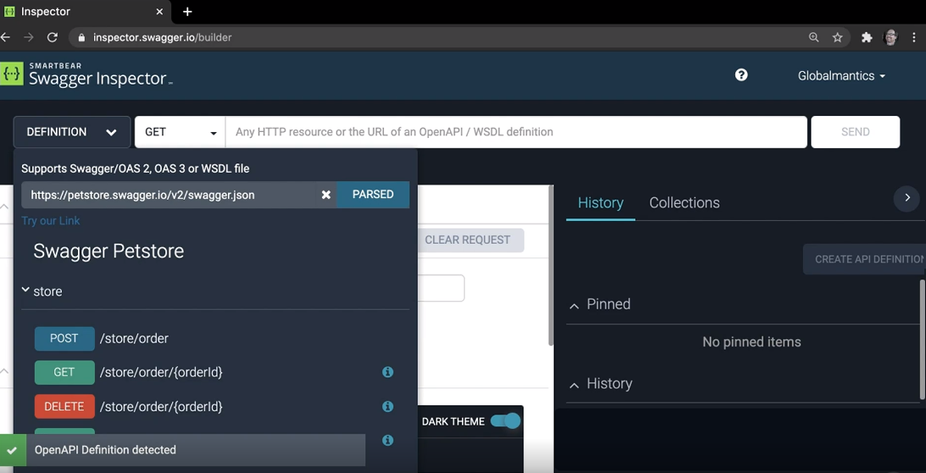

Slide 7
